Slide 1

Virtual Memory
Maxim Sheverlatov Jay Kothari William M. Mongan From Bryant and O’Hallaron: Computer Systems – A Programmer’s Perspective AND Operating Systems Concepts by Bryant and O’Hallaron

Slide 2
Problem: Processor-Memory Bottleneck
Processor performance
doubled about
every 18 months
Bus bandwidth
evolved much slower
Main Memory
CPU
Reg
Core 2 Duo:
Can process at least
256 Bytes/cycle
(1 SSE two operand add and mult)
Core 2 Duo:
Bandwidth
2 Bytes/cycle
Latency
100 cycles
Solution: Caches
Notes:
2

Slide 3
The Memory Hierarchy: Cache
Cache: a repository for copies that can be accessed more quickly than the original
Can’t make all memory available in small cache on-demand
Make frequent case (hit) fast and infrequent case (miss) less dominant
Caching underlies many of the techniques that are used today to make computers fast
Can cache: memory locations, address translations (page tables ➔ TLB), pages, file blocks, file names, network routes, etc.
Only good if:
Frequent case frequent enough and
Infrequent case not too expensive
Average Memory Access Time = (Hit Rate * Hit Time) + (Miss Rate * Miss Time)

Slide 4
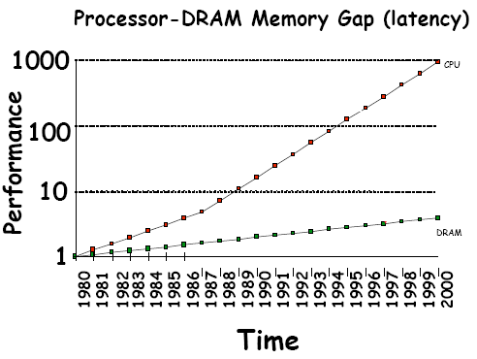
Why Cache?
Processor-DRAM latency gap
Processor: ~60% per year (doubles every 1.5 years)
Memory: ~9% per year (doubles every 10 years)
Gap grows 50% every year

Slide 5
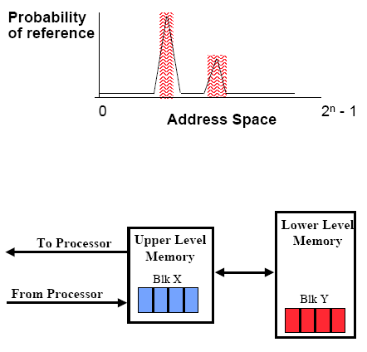
Why Cache?
Take advantage of temporal and spatial locality
Keep things that were accessed recently closer to the processor for temporal locality
Move contiguous blocks to upper levels for spatial locality

Slide 6
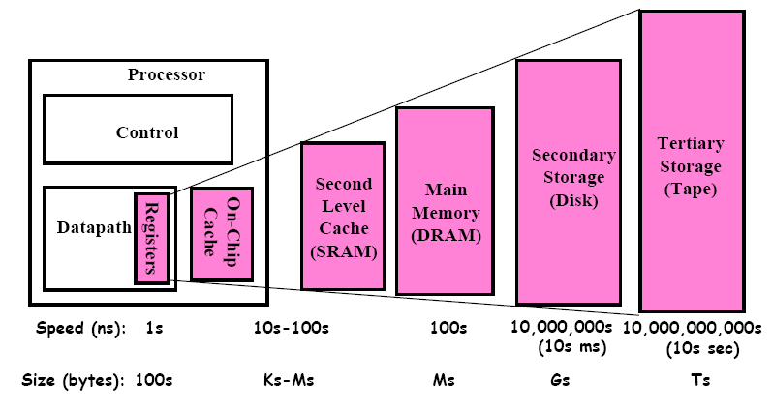
Why Cache?
Take advantage of temporal and spatial locality
Keep things that were accessed recently closer to the processor for temporal locality
Move contiguous blocks to upper levels for spatial locality

Slide 7
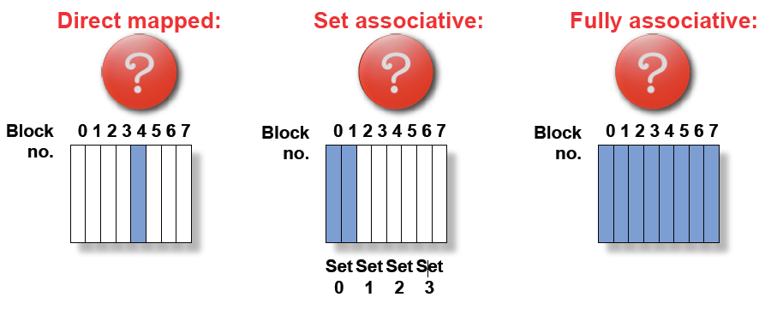
Where does data go into a cache?

Slide 8
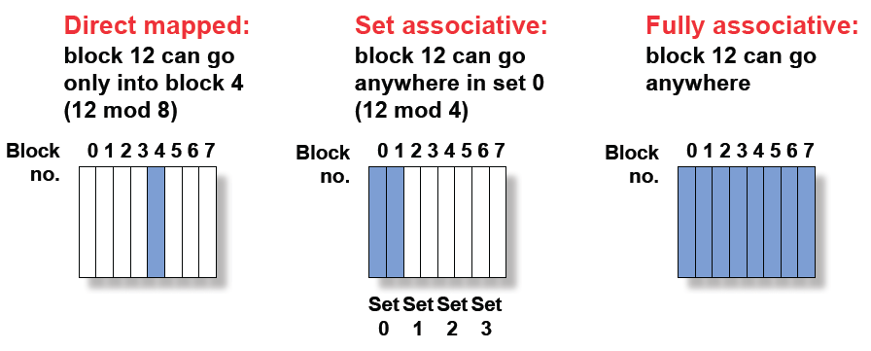
Where does data go into a cache?

Slide 9

Sources of Cache Misses
Compulsory (cold start or process migration, first reference)
Capacity
Conflict (collision)
Coherence (invalidation)

Slide 10
Sources of Cache Misses
Compulsory (cold start or process migration, first reference)
Cold fact of life: not a whole lot you can do about it
If you are going to run “billions” of instructions, these are insignificant
Capacity
Cache cannot contain all blocks accessed by the program
Solution: increase cache size
Conflict (collision)
Multiple memory locations mapped to the same location
Solution: increase cache size and/or associativity
Coherence (invalidation)
Other processes (e.g. I/O) updates memory

Slide 11
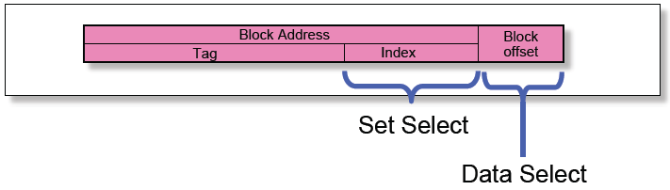
Accessing Data in a Cache
Index Used to Lookup Candidates in Cache
Index identifies the set
Tag used to identify actual copy (otherwise, cache miss)
Block is minimum quantum of caching
Data select field used to select data within block
Many caching applications don’t have data select field

Slide 12
Locating data in the Cache
Compare cache index (mapping) to Tag (high-order bits) to see if element is currently in cache.
Valid bit used to indicate whether data in cache is valid.
A hit occurs when the data requested is in cache, otherwise it is a miss.
The extra time required when a cache miss occurs is called the miss penalty.
Notes:
September 4, 1997
12

Slide 13
Mapping an Address to a Multiword Cache Block
(Block address) mod (Number of cache blocks)
Range: l = ⎣Byte address/Bytes per block⎦ × Bytes per block
r = l + (Bytes per block - 1)
Notes:
September 4, 1997
13

Slide 14
Locating a Block in Cache
Check the tag of every cache block in the appropriate set
Address consists of 3 parts
Replacement strategy:
E.G. Least Recently Used (LRU)
Notes:
September 4, 1997
14

Slide 15
What happens on a write?
Write-through: Write to both the cache and the block in lower level memory
Write-back: Only write to the cache for speed
Modified cache block is written to main memory only when it is replaced
Dirty bit indicates whether this write is required
Pros and Cons
Write-Through
Read misses cannot result in writes (+)
Processor held up on writes unless writes buffered (-)
Write-Back
Repeated writes not sent to DRAM (+)
Processor not held up on writes (+)
More complex (-)
Read miss may require writeback of dirty data (-)

Slide 16
Virtual Memory
Virtual memory – separation of user logical memory from physical memory.
Only part of the program needs to be in memory for execution
Logical address space can therefore be much larger than physical address space
Allows address spaces to be shared by several processes
Allows for more efficient process creation
Virtual memory can be implemented via:
Demand paging
Demand segmentation
Notes:
16

Slide 17
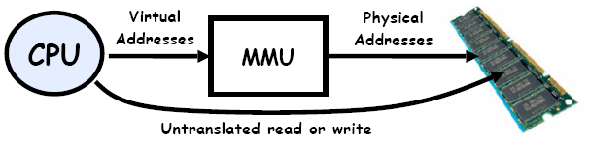
Two Views of Memory
Address Space:
All the addresses and state a process can touch
Each process and kernel as a different address space
Consequently, two views of memory:
View from the CPU (what program sees – virtual memory)
View from memory (physical memory)
Translation “box” converts between the two views; only the kernel can modify
Translation helps to implement protection
If task A cannot even gain access to task B’s data, no way for A to adversely affect B
With translation, every program can be linked/loaded into same region of user address space
Overlap avoided through translation, not relocation
Every main() thinks it is starting at the same address!

Slide 18
Process Virtual Memory Image
kernel virtual memory
memory protected from user code
stack
%esp
Allocators request
additional heap memory
from the kernel using the sbrk() function:
error = sbrk(amt_more)
the “brk” ptr
run-time heap (via malloc)
uninitialized data (.bss)
initialized data (.data)
program text (.text)
0

Slide 19
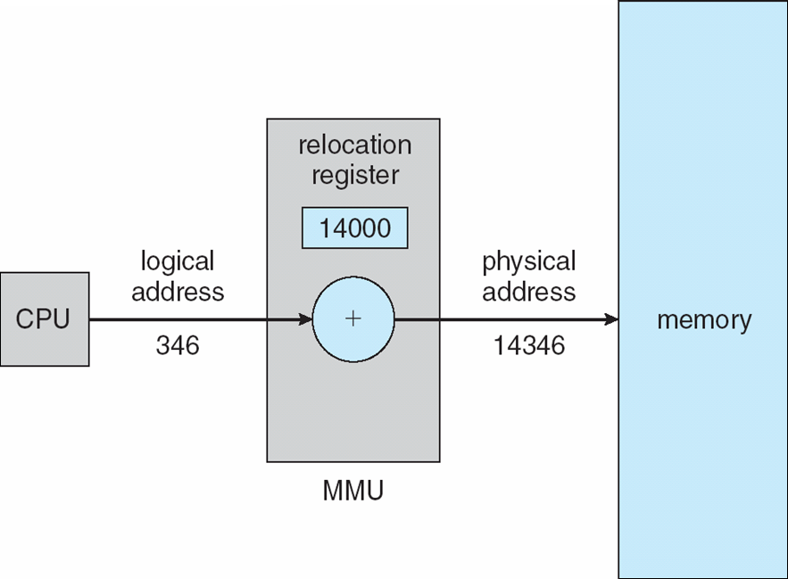
Dynamic relocation using a relocation register
Notes:
19

Slide 20
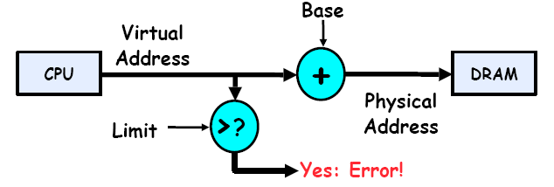
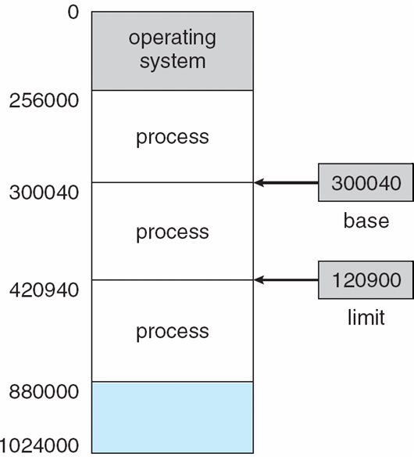
Base and Limit Registers
A pair of base and limit registers define the logical address space (segment)
Translate virtual address to physical address by adding “base” – so long as it is within the range specified by the “limit.”
All addresses relative to the segment, so no relocation needed when the base or limit changes.
Notes:
20

Slide 21
Base and Limit Registers
This gives the illusion that the program is running on its own dedicated machine, with memory starting at 0
Program gets continuous region of memory
Addresses within the program do not have to be relocated when the program is placed in a different region of DRAM, or when the program is moved to another segment.
Notes:
21

Slide 22
Contiguous Allocation
Main memory usually into two partitions:
Resident operating system, usually held in low memory with interrupt vector
User processes then held in high memory
Relocation registers used to protect user processes from each other, and from changing operating-system code and data
Base register contains value of smallest physical address
Limit register contains range of logical addresses – each logical address must be less than the limit register
MMU maps logical address dynamically
Notes:
22

Slide 23
Issues with Contiguous Allocation Method
Though it is simple, it suffers from some problems:
Fragmentation problem
Not every process is the same size
Over time, memory space becomes fragmented
It is difficult for the process memory space to grow dynamically (e.g. heap)
Hard to do interprocess sharing
Want to share code segments when possible (libraries)
Want to share memory between processes
How to do this without sharing the entire segment?
Helped by providing multiple segments per process
Need enough memory for every process

Slide 24
Contiguous Allocation
Multiple-partition allocation
Hole – block of available memory; holes of various size are scattered throughout memory
When a process arrives, it is allocated memory from a hole large enough to accommodate it
Operating system maintains information about: a) allocated partitions b) free partitions (hole)
OS
OS
OS
OS
process 5
process 5
process 5
process 5
process 9
process 9
process 8
process 10
process 2
process 2
process 2
process 2
Notes:
24

Slide 25
Dynamic Storage-Allocation Problem
How to satisfy a request of size n from a list of free holes
First-fit: Allocate the first hole that is big enough
Best-fit: Allocate the smallest hole that is big enough; must search entire list, unless ordered by size
Produces the smallest leftover hole
Worst-fit: Allocate the largest hole; must also search entire list
Produces the largest leftover hole
First-fit and best-fit better than worst-fit in terms of speed and storage utilization
Notes:
25

Slide 26
Fragmentation
External Fragmentation – total memory space exists to satisfy a request, but it is not contiguous
Internal Fragmentation – allocated memory may be slightly larger than requested memory; this size difference is memory internal to a partition, but not being used
Reduce external fragmentation by compaction
Shuffle memory contents to place all free memory together in one large block
Compaction is possible only if relocation is dynamic, and is done at execution time
I/O problem
Latch job in memory while it is involved in I/O
Do I/O only into OS buffers
Notes:
26

Slide 27
More Flexible Segmentation
Memory-management scheme that supports user view of memory
A program is a collection of segments
A segment is a logical unit such as:
main program
procedure
function
method
object
local variables, global variables
common block
stack
symbol table
arrays
Notes:
27

Slide 28
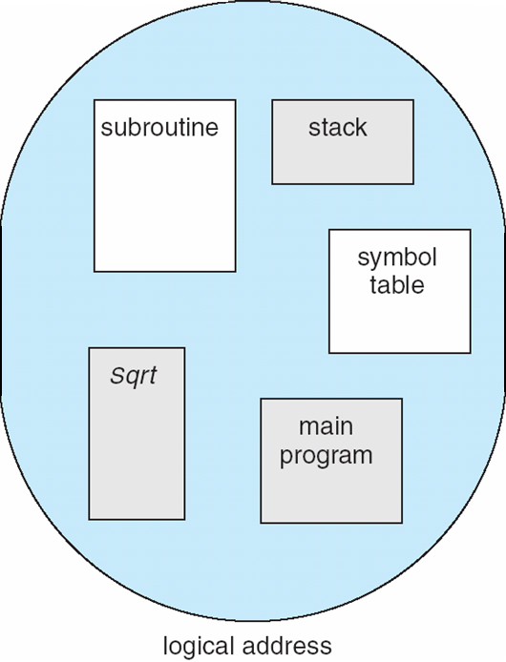
User’s View of a Program
Notes:
28

Slide 29
Logical View of Segmentation
1
1
4
2
3
4
2
3
user space
physical memory space
Notes:
29

Slide 30
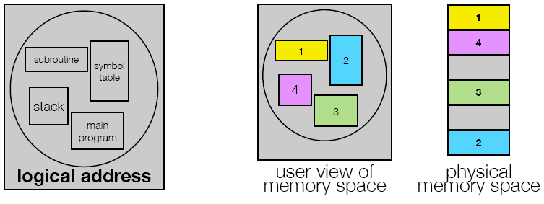
Segmentation
Logical View: multiple separate segments
Typical: code, data, stack
Enables more precise memory sharing
Each segment is given a region of contiguous memory
Has a base and limit
Can reside anywhere in physical memory

Slide 31
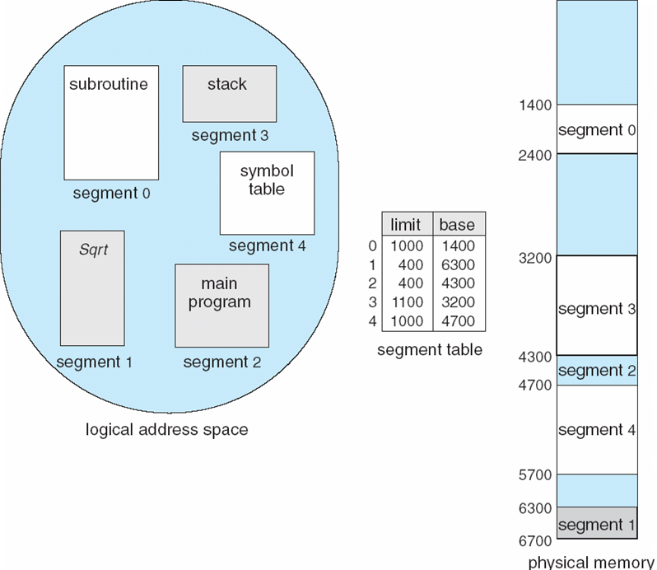
Example of Segmentation
Notes:
31

Slide 32
Segmentation Architecture
Logical address consists of a two tuple:
<segment-number, offset>,
Segment table – maps two-dimensional physical addresses; each table entry has:
base – contains the starting physical address where the segments reside in memory
limit – specifies the length of the segment
Segment-table base register (STBR) points to the segment table’s location in memory
Segment-table length register (STLR) indicates number of segments used by a program;
segment number s is legal if s < STLR
Notes:
32

Slide 33
Segmentation Architecture
Protection
With each entry in segment table associate:
validation bit = 0 ⇒ illegal segment
read/write/execute privileges
Protection bits associated with segments; code sharing occurs at segment level
Since segments vary in length, memory allocation is a dynamic storage-allocation problem
A segmentation example is shown in the following diagram
Notes:
33

Slide 34
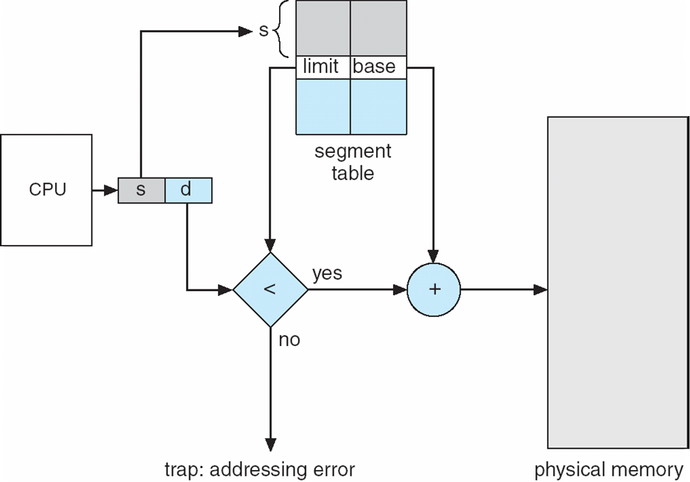
Segmentation Hardware
Notes:
34

Slide 35
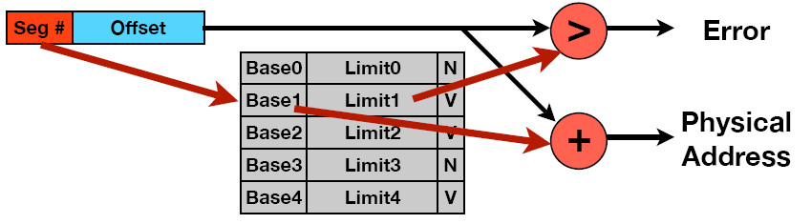
Implementing the Multi-Segment Model
Segment map resides in processor
Segment number mapped into base/limit pair
Base added to offset to generate physical address (and checked against range limit)
As many chunks of physical memory as entries
Segment addressed by portion of virtual address
What is V/N?
Can mark segments as invalid – why not just clear entries?

Slide 36
Paging
Logical address space of a process can be noncontiguous; process is allocated physical memory whenever the latter is available
Divide physical memory into fixed-sized blocks called frames (size is power of 2, between 512 bytes and 8,192 bytes)
Divide logical memory into blocks of same size called pages
Keep track of all free frames
To run a program of size n pages, need to find n free frames and load program
Set up a page table to translate logical to physical addresses
Internal fragmentation
Notes:
36

Slide 37
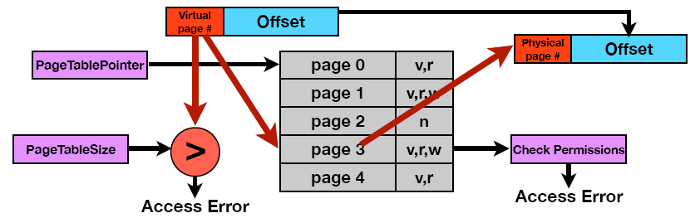
Implementing Paging
Page Table (one per process)
Resides in physical memory
Contains physical page and permission for each virtual page (valid, read/write, etc.)
Virtual address mapping
Offset from virtual address copied to physical address
10 bit offset -> 1024-byte pages
Addresses are relative to a page
Virtual page # is all remaining bits
Example for 32 bits: 32-10=22 bits, i.e. 4 million entries
Physical page # copied from table into physical address
Check page table bounds and permissions

Slide 38
Address Translation Scheme
Address generated by CPU is divided into:
Page number (p) – used as an index into a page table which contains base address of each page in physical memory
Page offset (d) – combined with base address to define the physical memory address that is sent to the memory unit
For given logical address space 2^{m} and page size 2^{n}
page number
page offset
p
d
m - n
n
Notes:
38

Slide 39
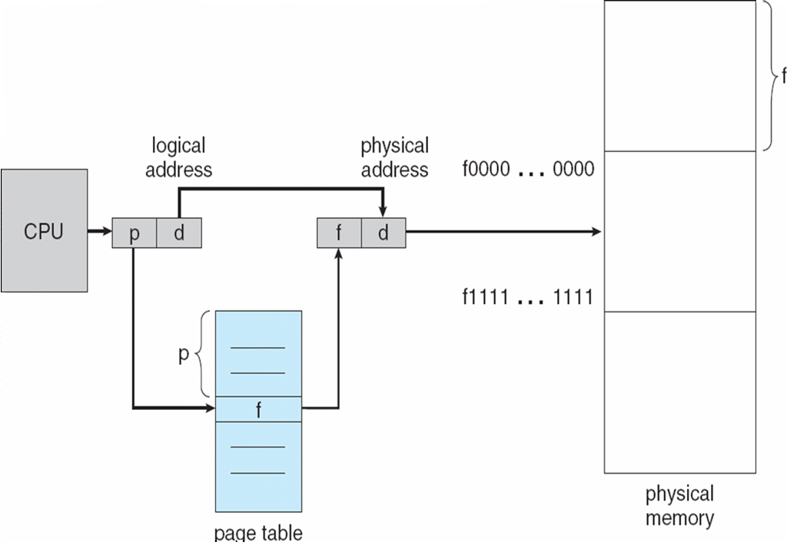
Paging Hardware
Notes:
39

Slide 40

Paging Model of Logical and Physical Memory
Notes:
40

Slide 41

Paging Example
32-byte memory and 4-byte pages
Notes:
41

Slide 42

Free Frames
Before allocation
After allocation
Notes:
42

Slide 43
Implementation of Page Table
Page table is kept in main memory
Page-table base register (PTBR) points to the page table
Page-table length register (PRLR) indicates size of the page table
In this scheme every data/instruction access requires two memory accesses. One for the page table and one for the data/instruction.
The two memory access problem can be solved by the use of a special fast-lookup hardware cache called associative memory or translation look-aside buffers (TLBs)
Some TLBs store address-space identifiers (ASIDs) in each TLB entry – uniquely identifies each process to provide address-space protection for that process
Notes:
43

Slide 44
Shared Pages
Shared code
One copy of read-only (reentrant) code shared among processes (i.e., text editors, compilers, window systems).
Shared code must appear in same location in the logical address space of all processes
Private code and data
Each process keeps a separate copy of the code and data
The pages for the private code and data can appear anywhere in the logical address space
Notes:
44

Slide 45
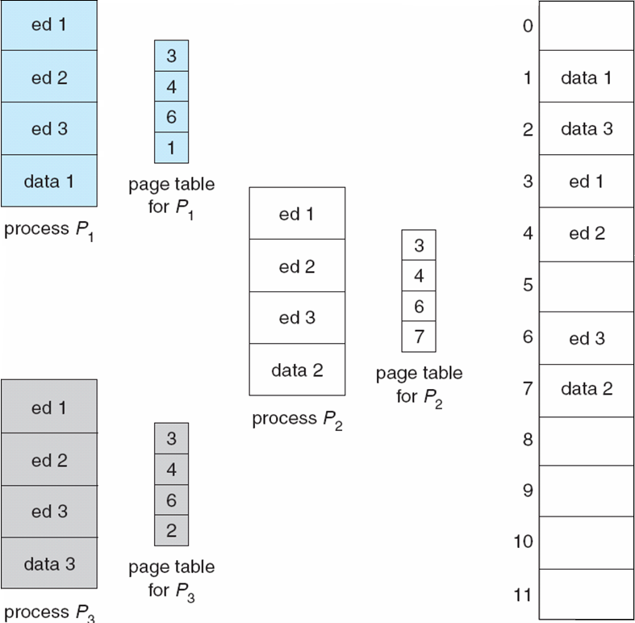
Shared Pages Example
Notes:
45

Slide 46
Structure of the Page Table
Hierarchical Paging (Forward Page Tables)
Inverted Page Tables
Hashed Page Tables
Notes:
46

Slide 47
Hierarchical Page Tables
Break up the logical address space into multiple page tables
A simple technique is a two-level page table
Notes:
47

Slide 48
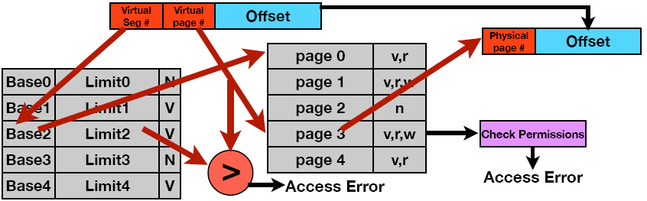
Multi-Level Translation
What must be saved/restored on context switch?
Sharing
Complete segments
Individual pages

Slide 49
Multi-Level Translation
What must be saved/restored on context switch?
Contents of top level segment registers (for this example)
Pointer to top level table (page table)
Sharing
Complete segments
Individual pages

Slide 50
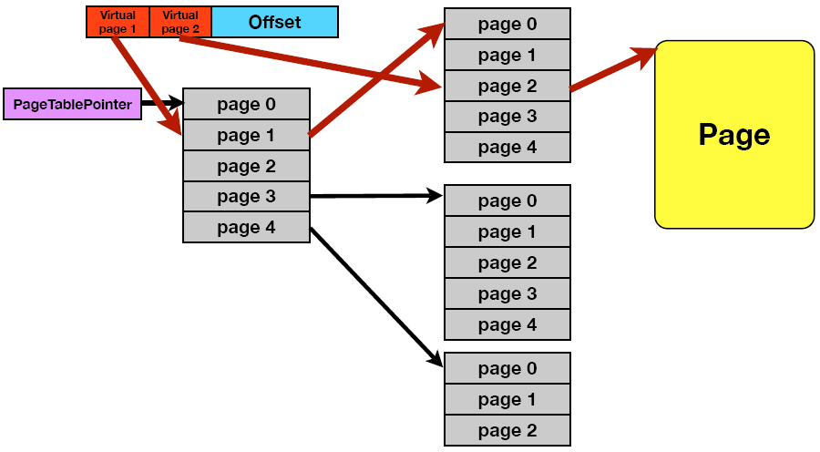
Two-Level Page-Table Scheme
Notes:
50

Slide 51
Two-Level Paging Example
A logical address (on 32-bit machine with 1K page size) is divided into:
a page number consisting of 22 bits
a page offset consisting of 10 bits
Since the page table is paged, the page number is further divided into:
a 12-bit page number
a 10-bit page offset
Thus, a logical address is as follows: where p_{i} is an index into the outer page table, and p₂ is the displacement within the page of the outer page table
page number
page offset
p_{i}
p₂
d
12
10
10
Notes:
51

Slide 52

Address-Translation Scheme
Notes:
52

Slide 53


Three-level Paging Scheme
Notes:
53

Slide 54
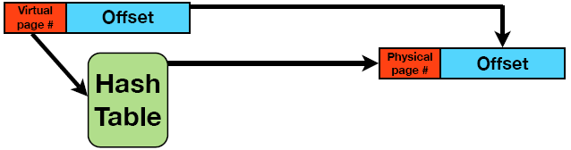
Inverted Page Table
The size of these page tables is at least as large as the amount of virtual memory allocated to each process.
Physical memory may be much less
Much of process space may be out on disk or not in use
Use a hash table instead
Inverted page table is independent of virtual address space
Directly related to amount of physical memory instead
Very attractive option for 64-bit address spaces
Cons: complexity in managing hash changes
Often in hardware!
Notes:
54

Slide 55
Inverted Page Table
One entry for each real page of memory
Entry consists of the virtual address of the page stored in that real memory location, with information about the process that owns that page
Decreases memory needed to store each page table, but increases time needed to search the table when a page reference occurs
Use hash table to limit the search to one — or at most a few — page-table entries
Notes:
55

Slide 56

Inverted Page Table Architecture
Notes:
56

Slide 57
Hashed Page Tables
Common in address spaces > 32 bits
The virtual page number is hashed into a page table
This page table contains a chain of elements hashing to the same location
Virtual page numbers are compared in this chain searching for a match
If a match is found, the corresponding physical frame is extracted
Notes:
57

Slide 58

Hashed Page Table
Notes:
58

Slide 59
Example: The Intel Pentium
Supports both segmentation and segmentation with paging
CPU generates logical address
Given to segmentation unit
Which produces linear addresses
Linear address given to paging unit
Which generates physical address in main memory
Paging units form equivalent of MMU
Notes:
59

Slide 60
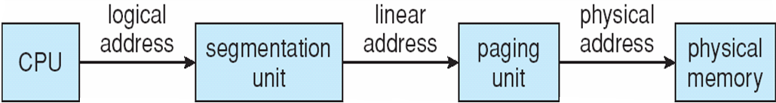
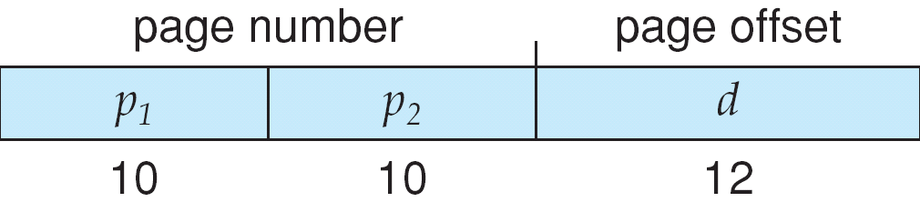
Logical to Physical Address Translation in Pentium
Notes:
60

Slide 61
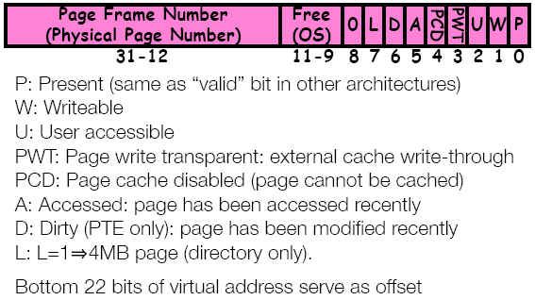
What is in a Page Table Entry (PTE)
Pointer to the next-level page table or the actual page
Permission bits: valid, read-only, read-write, write-only
Example: Intel x86 PTE
Address format shown above
Intermediate page tables called directories

Slide 62
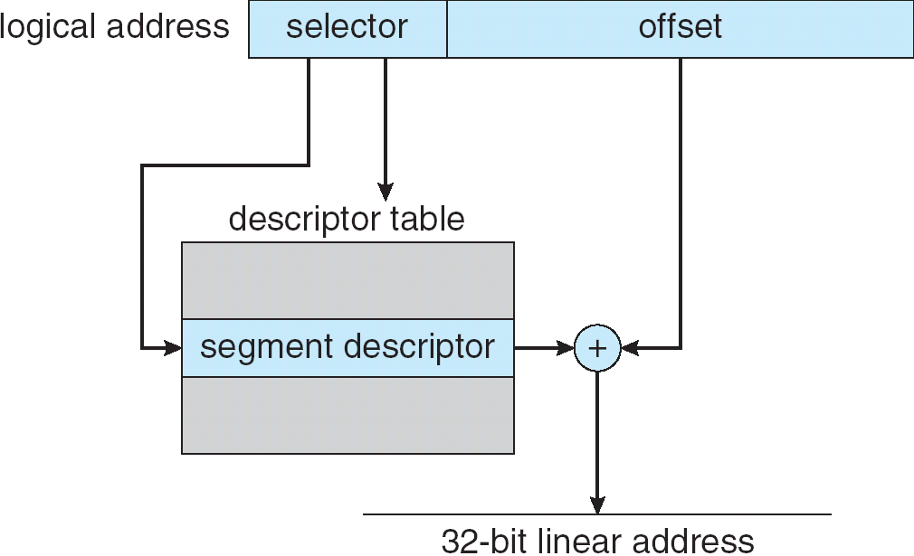
Intel Pentium Segmentation
Notes:
62

Slide 63
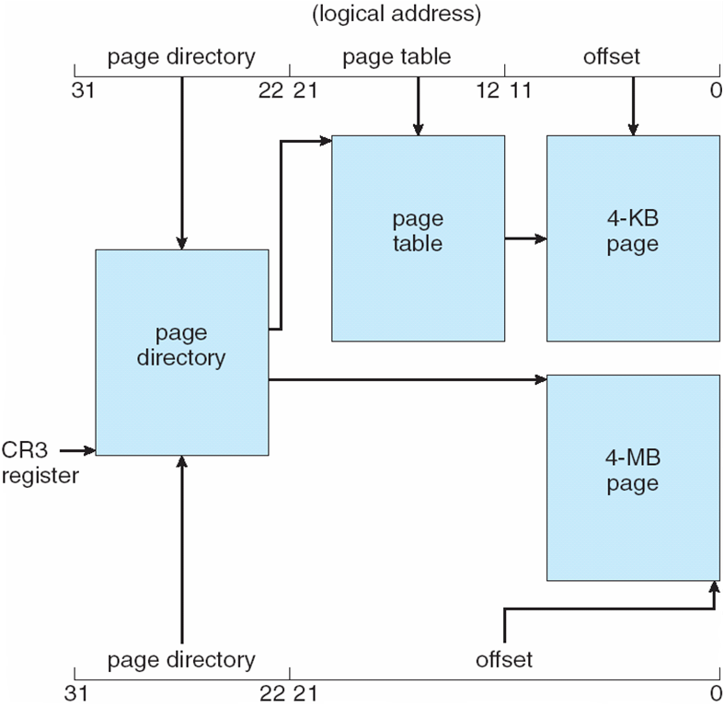
Pentium Paging Architecture
Notes:
63

Slide 64

Linear Address in Linux
Broken into four parts:
Notes:
64

Slide 65
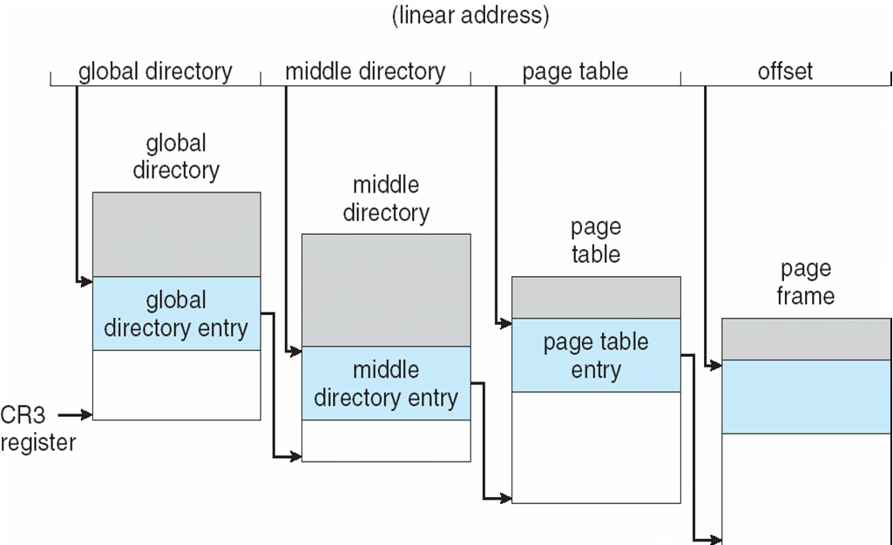
Three-level Paging in Linux
Notes:
65

Slide 66
Swapping
A process can be swapped temporarily out of memory to a backing store, and then brought back into memory for continued execution
Backing store – fast disk large enough to accommodate copies of all memory images for all users; must provide direct access to these memory images
Roll out, roll in – swapping variant used for priority-based scheduling algorithms; lower-priority process is swapped out so higher-priority process can be loaded and executed
Major part of swap time is transfer time; total transfer time is directly proportional to the amount of memory swapped
Modified versions of swapping are found on many systems (i.e., UNIX, Linux, and Windows)
System maintains a ready queue of ready-to-run processes which have memory images on disk
Notes:
66

Slide 67
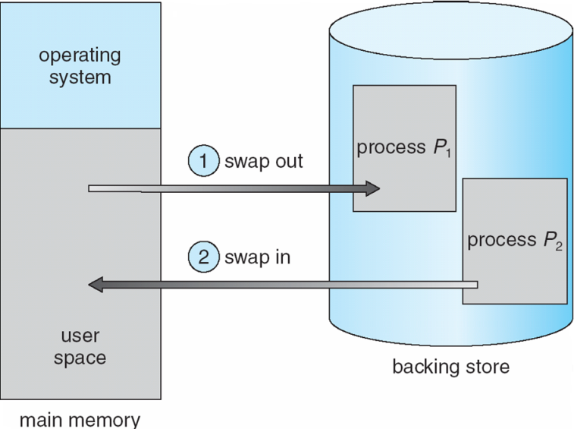
Schematic View of Swapping
Extreme form of context switch
In order to make room for the next process, some or all of the previous process is moved to disk
Likely need to send out complete segments
This greatly increases the cost of context switching
Desirable alternative
Some way to keep only active portions of a process in memory at any one time
Need finer granularity control over physical memory
Notes:
67

Slide 68
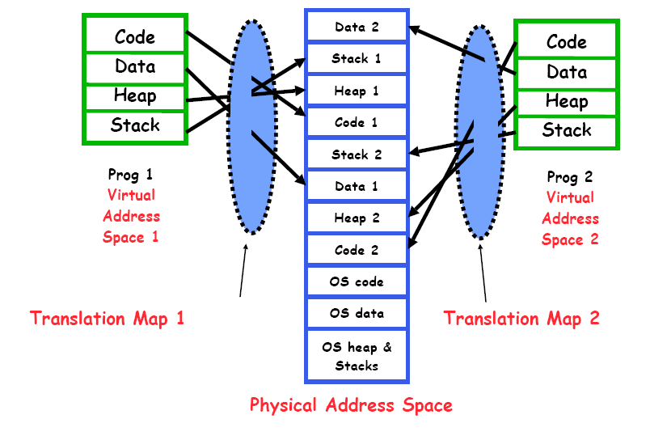
Example of General Address Translation

Slide 69
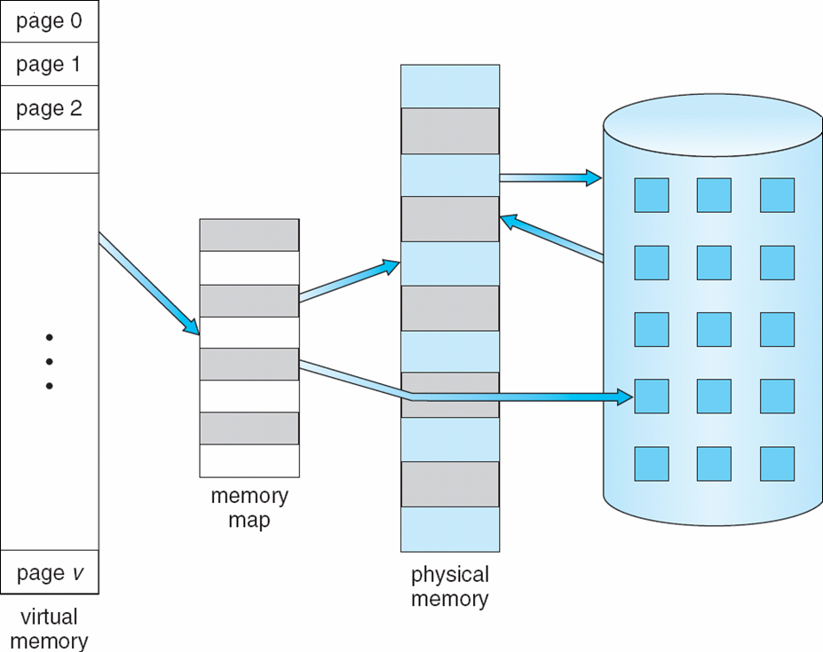
Virtual Memory That is Larger Than Physical Memory
⇒
Notes:
69

Slide 70
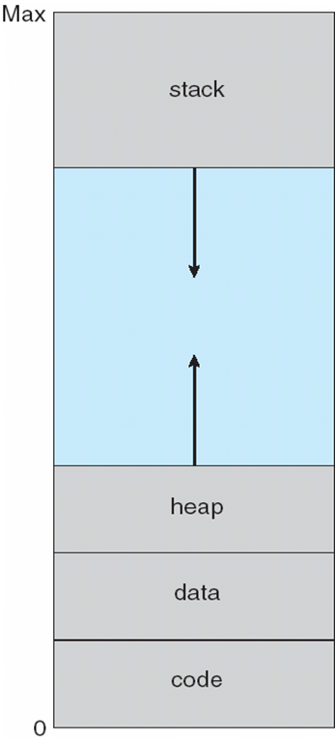
Virtual-address Space
Notes:
70

Slide 71
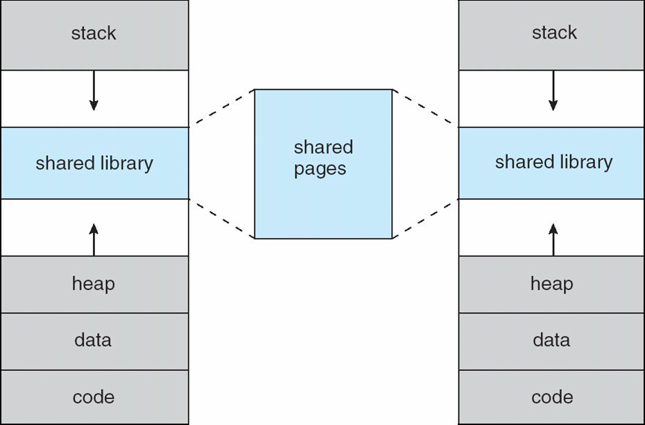
Shared Library Using Virtual Memory
Notes:
71

Slide 72
Caching Address Translation (TLB)
Can’t afford to touch the page table and translate on every access
At least 3 DRAM access per actual DRAM access
Or possibly disk access!
Worse, what if we are using caching to make memory access faster than DRAM access? Then we touch DRAM to access cache.
Cache translations with the TLB

Slide 73
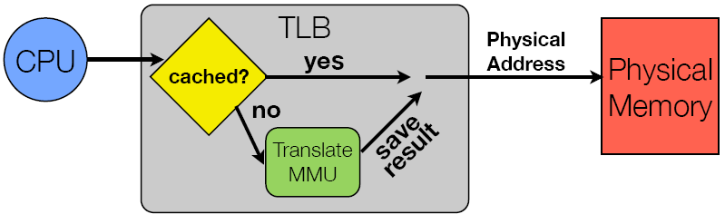
Caching Address Translation (TLB)
Does page locality exist?
Instruction accesses spend a lot of time on the same page (since accesses sequential)
Stack addresses have definite locality of reference
Data accesses have less page locality, but still some
TLB hierarchy possible, with multiple levels at different sizes and speeds (just like traditional data cache!)

Slide 74
Associative Memory
Associative memory – parallel search for frame number
Address translation (p, d)
If p is in associative register, get frame # out
Otherwise get frame # from page table in memory
Notes:
74

Slide 75

Paging Hardware With TLB
Notes:
75

Slide 76
Effective Access Time
Associative Lookup = ε time unit
Assume memory cycle time is 1 microsecond
Hit ratio – percentage of times that a page number is found in the associative registers; ratio related to number of associative registers
Hit ratio = α
Effective Access Time (EAT)
EAT = (1 + ε) α + (2 + ε)(1 – α)
= 2 + ε – α
Notes:
76

Slide 77
What Happens on a TLB Miss?
Hardware traversed page tables:
On TLB miss, hardware in MMU looks at current page table to fill TLB (may walk multiple levels)
If PTE valid, hardware fills TLB and processor never knows
If PTE marked as invalid, page fault, and the kernel decides what to do
Software traversed page tables (MIPS):
On TLB miss, processor receives TLB fault
Processor fault handler typically handles this fault first for speed
Kernel traverses page table to find PTE
If PTE valid, fill TLB and return from fault
If PTE invalid, internally call page fault handler
Most chipsets provide hardware traversal
Modern OS tend to have more TLB faults since they use translation for many things, like shared segments and user-level portions of the OS

Slide 78
What Happens on a Context Switch?
TLB maps virtual addresses to physical addresses
Since the address space just changed, TLB entries are no longer valid
Options
Invalid TLB (simple but expensive – what if there are frequent context switches?)
Include PID in the TLB (requires hardware support)
What if translation tables change?
What if a page is swapped in or out, or replaced?
MUST invalidate TLB entry
Otherwise, might think the page is still in memory!

Slide 79
What TLB Organization Makes Sense?
Sits between CPU and cache
As such, needs to be very fast
Critical path of memory access: this reduces effective cache speed since TLB lookup is at a minimum on accesses to cache
Hence, L1 cache is often virtually addressed
So, TLB should be direct mapped or be low associativity?
But we can’t afford conflict misses!
TLB miss time is very high
So the cost of a conflict miss is much higher than a slightly increased hit time
What if we use low order bits of page as index into TLB?
First page of code, data, stack may map to same entry
Need at least 3-way associativity
What if we use high order bits as index?
TLB mostly unused for small programs

Slide 80
TLB Organization
TLB is usually small: 128-512 entries
Small size supports high associativity: often fully associative
Lookup is by virtual address, PTE is returned
What if fully-associative is too slow for me?

Slide 81
TLB Organization
TLB is usually small: 128-512 entries
Small size supports high associativity: often fully associative
Lookup is by virtual address, PTE is returned
What if fully-associative is too slow for me?
Put a small (4-16) entry direct mapped cache in front
Called a “TLB slice”
Also, overlap TLB lookup with cache access, since the offset is already available

Slide 82
Demand Paging
Bring a page into memory only when it is needed
Less I/O needed
Less memory needed
Faster response
More users
Page is needed ⇒ reference to it
invalid reference ⇒ abort
not-in-memory ⇒ bring to memory
Lazy swapper – never swaps a page into memory unless page will be needed
Swapper that deals with pages is a pager
Notes:
82

Slide 83
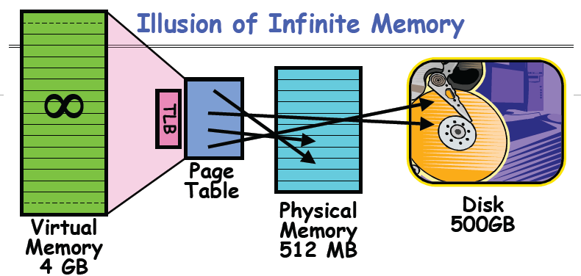
Demand Paging
Disk is larger than physical memory, so in-use virtual memory can be bigger than physical memory
Combined memory of running processes can also be much larger than physical memory
More programs fit into memory, allowing more concurrency

Slide 84
Demand Paging
Principle: transparent level of indirection (page table)
Supports flexible placement of physical data
Data could be on disk, or even across network
Variable location of data transparent to user program
Performance issue, not correctness issue

Slide 85
Demand Paging
Demand Paging is Caching:
What is block size? (1 page)
What is the organization?
Fully associative: arbitrary virtual → physical mapping
How do we find a page in the cache?
Check TLB, then page-table
What is page replacement policy (LRU, random, etc.)?
This is today’s topic!
What happens on a miss?
Page fault: go to disk, and possibly swap a page out to disk to make room
What happens on a write (write-through, write-back)
Definitely write-back! Need a dirty bit!

Slide 86
Demand Paging
PTE helps us implement paging
Valid/invalid bit indicates if page is in memory or on disk
Suppose user references page with invalid PTE?
MMU traps to OS as a page fault
What does the OS do?
Choose an old page to replace
If old page is dirty, write contents back to disk
Invalidate PTE and any cached TLB entry for old page
Load new page into memory from disk
Update PTE
Continue thread from original faulting location
TLB for new page will be loaded when thread continues
While pulling pages off disk for one process, OS runs another process from ready queue
After all, the faulting process is essentially blocking on disk I/O
Suspended process sits on wait queue

Slide 87
Demand Paging
PTE helps us implement paging
Valid/invalid bit indicates if page is in memory or on disk
Suppose user references page with invalid PTE?
MMU traps to OS as a page fault
What does the OS do?
Choose an old page to replace
If old page is dirty, write contents back to disk
Invalidate PTE and any cached TLB entry for old page
Load new page into memory from disk
Update PTE
Continue thread from original faulting location
TLB for new page will be loaded when thread continues
While pulling pages off disk for one process, OS runs another process from ready queue
After all, the faulting process is essentially blocking on disk I/O
Suspended process sits on wait queue
Cache!

Slide 88
Valid-Invalid Bit
With each page table entry a valid–invalid bit is associated (v ⇒ in-memory, i ⇒ not-in-memory)
Initially valid–invalid bit is set to i on all entries
Example of a page table snapshot:
During address translation, if valid–invalid bit in page table entry
is I ⇒ page fault
Frame #
valid-invalid bit
v
v
v
v
i
….
i
i
Notes:
88

Slide 89
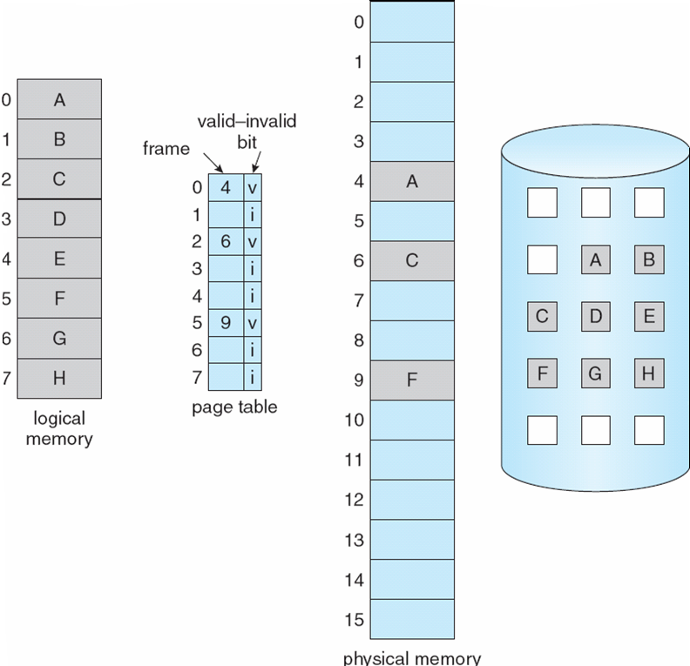
Page Table When Some Pages Are Not in Main Memory
Notes:
89

Slide 90

Steps in Handling a Page Fault
Notes:
90

Slide 91
Performance of Demand Paging
Page Fault Rate 0 ≤ p ≤ 1.0
if p = 0 no page faults
if p = 1, every reference is a fault
Effective Access Time (EAT)
EAT = (1 – p) x memory access
+ p (page fault overhead
+ swap page out
+ swap page in
+ restart overhead
)
Notes:
91

Slide 92
Demand Paging Example
Memory access time = 200 nanoseconds
Average page-fault service time = 8 milliseconds
EAT = (1 – p) x 200 + p (8 milliseconds)
= (1 – p) x 200 + p x 8,000,000
= 200 x (1 – p) + p x 7,999,800
If one access out of 1,000 causes a page fault, then
EAT = 8.2 microseconds.
This is a slowdown by a factor of 40!!
Notes:
92

Slide 93
Demand Paging
Does software-loaded TLB need a use bit?
Two options
Hardware sets use bit in TLB
When TLB entry is replaced, software copies use bit back to page table
Software manages TLB entries as FIFO list
Everything not in TLB is Second-Chance list, managed as strict LRU
Core Map
Page tables map virtual page → physical page
Do we need a reverse mapping (i.e. physical page → virtual page)?
Yes, clock algorithm runs through page frames. If sharing, then multiple virtual-pages per physical frame can exist
Can’t push page out to disk without invalidating all of the PTEs

Slide 94
Copy-on-Write
Copy-on-Write (COW) allows both parent and child processes to initially share the same pages in memory If either process modifies a shared page, only then is the page copied
COW allows more efficient process creation as only modified pages are copied
Free pages are allocated from a pool of zeroed-out pages
Notes:
94

Slide 95
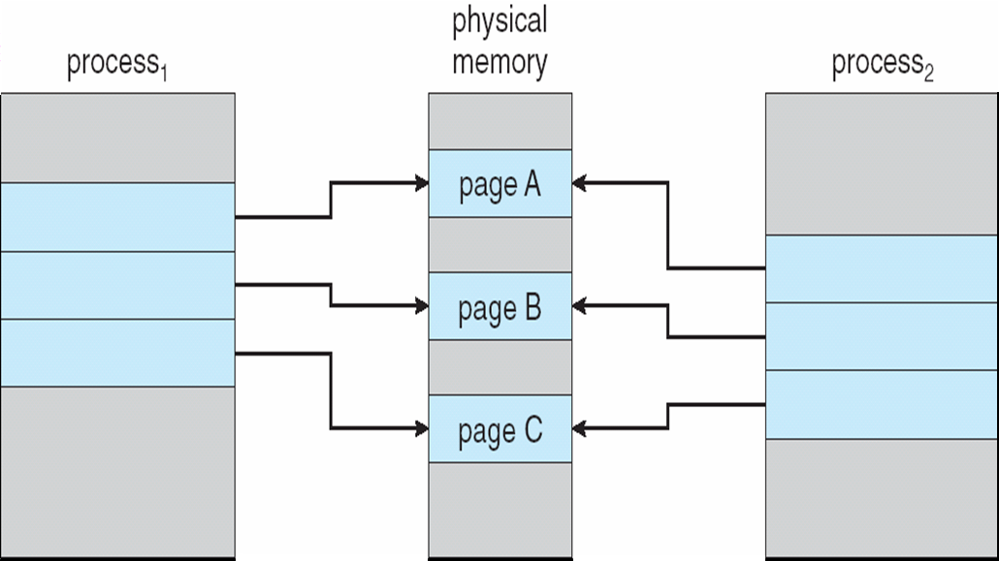
Before Process 1 Modifies Page C
Notes:
95

Slide 96
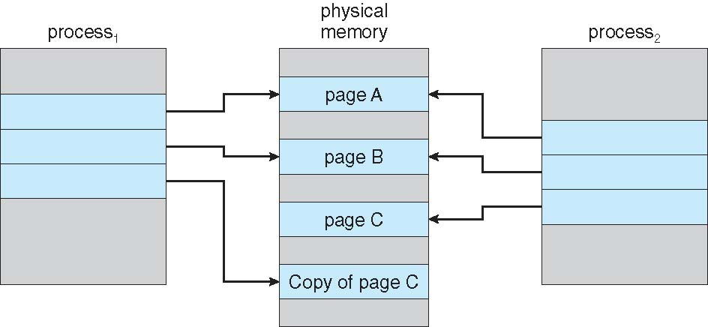
After Process 1 Modifies Page C
Notes:
96

Slide 97
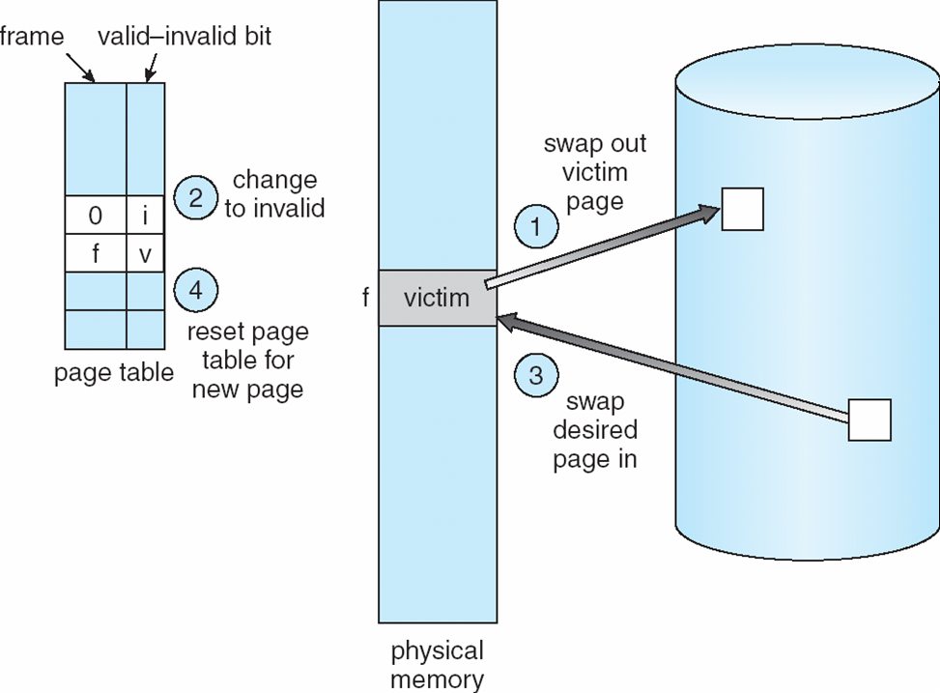
Page Replacement
Notes:
97

Slide 98
Page Replacement Algorithms
Replacement is a performance issue: the cost of being wrong is high (going to disk)
Keep “important” pages in memory, not toss them out
FIFO
Throw out oldest page. Be fair – let every page live in memory for same amount of time
Bad, because throws out heavily used pages instead of infrequently used ones
MIN
Replace page that won’t be used for the longest time
Great, but can’t know the future
Used for comparison
RANDOM
Simple: typical solution for TLB’s
Unpredictable, makes it hard to make real-time guarantees

Slide 99
Page Replacement Algorithms
Want lowest page-fault rate
Evaluate algorithm by running it on a particular string of memory references (reference string) and computing the number of page faults on that string
In all our examples, the reference string is
1, 2, 3, 4, 1, 2, 5, 1, 2, 3, 4, 5
Notes:
99

Slide 100
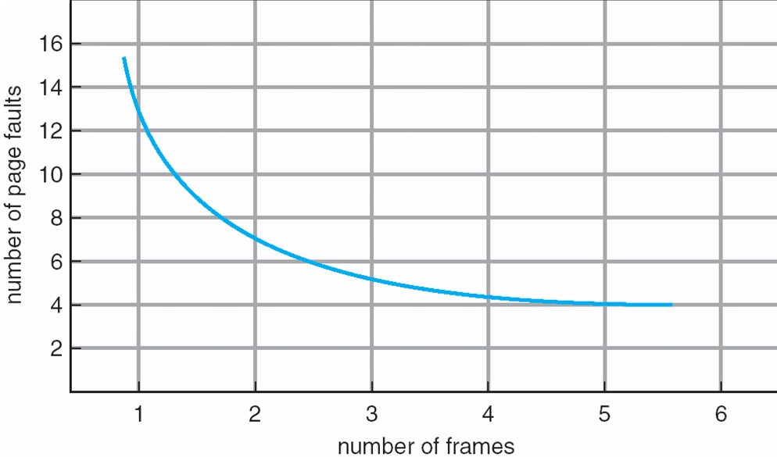
Graph of Page Faults Versus The Number of Frames
Ideally, adding memory, the miss rate should go down (above)
Is this always the case?
It would seem so!
Belady’s Anomaly: Some replacement algorithms don’t have this obvious property
FIFO
Notes:
100

Slide 101
First-In-First-Out (FIFO) Algorithm
Reference string: 1, 2, 3, 4, 1, 2, 5, 1, 2, 3, 4, 5
3 frames (3 pages can be in memory at a time per process)
4 frames
Belady’s Anomaly: more frames ⇒ more page faults
1
1
4
5
2
2
1
3
9 page faults
3
3
2
4
1
1
5
4
2
2
1
5
10 page faults
3
3
2
4
4
3
Notes:
101

Slide 102
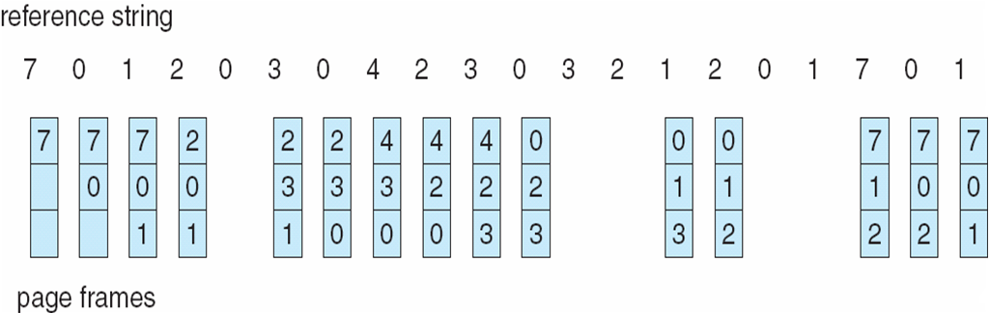
FIFO Page Replacement
Notes:
102

Slide 103
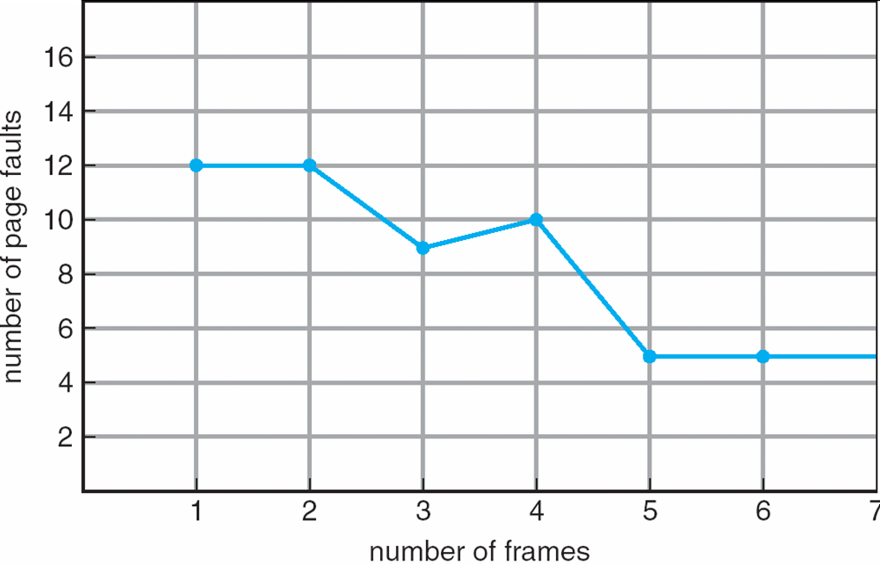
FIFO Illustrating Belady’s Anomaly
Notes:
103

Slide 104
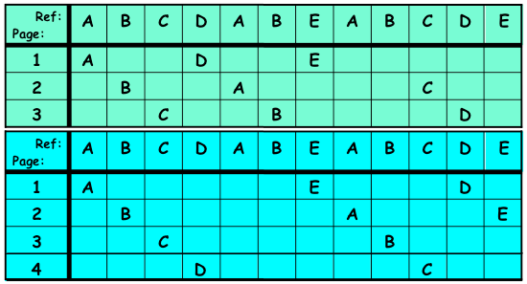
Belady’s Anomaly

Slide 105
MIN: Optimal Algorithm
Replace page that will not be used for longest period of time
4 frames example
1, 2, 3, 4, 1, 2, 5, 1, 2, 3, 4, 5
How do you know this?
Used for measuring how well your algorithm performs
1
4
2
6 page faults
3
4
5
Notes:
105

Slide 106
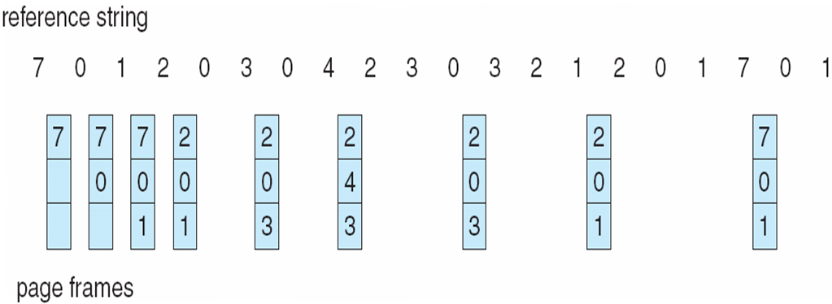
MIN: Optimal Page Replacement
Notes:
106

Slide 107
Least Recently Used (LRU) Algorithm
Reference string: 1, 2, 3, 4, 1, 2, 5, 1, 2, 3, 4, 5
List Implementation
On each use, remove page from list and place it at head
LRU page is at the tail
But need to traverse the list to move a page from the middle to the head
1
1
1
1
5
2
2
2
2
2
3
5
5
4
4
4
4
3
3
3
Notes:
107

Slide 108
Least Recently Used (LRU) Algorithm
Reference string: 1, 2, 3, 4, 1, 2, 5, 1, 2, 3, 4, 5
Counter implementation
Every page entry has a counter; every time page is referenced through this entry, copy the clock into the counter
When a page needs to be changed, look at the counters to determine which are to change
1
1
1
1
5
2
2
2
2
2
3
5
5
4
4
4
4
3
3
3
Notes:
108

Slide 109
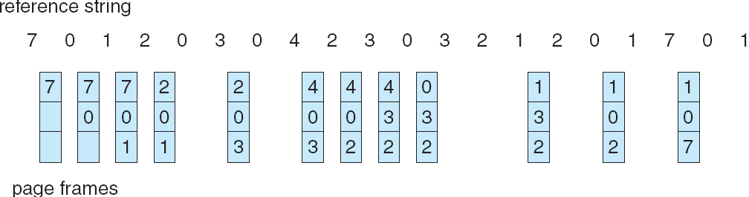
LRU Page Replacement
Notes:
109

Slide 110
LRU Algorithm (Cont.)
Stack implementation – keep a stack of page numbers in a double link form:
Page referenced:
move it to the top
requires 6 pointers to be changed
No search for replacement
Notes:
110

Slide 111
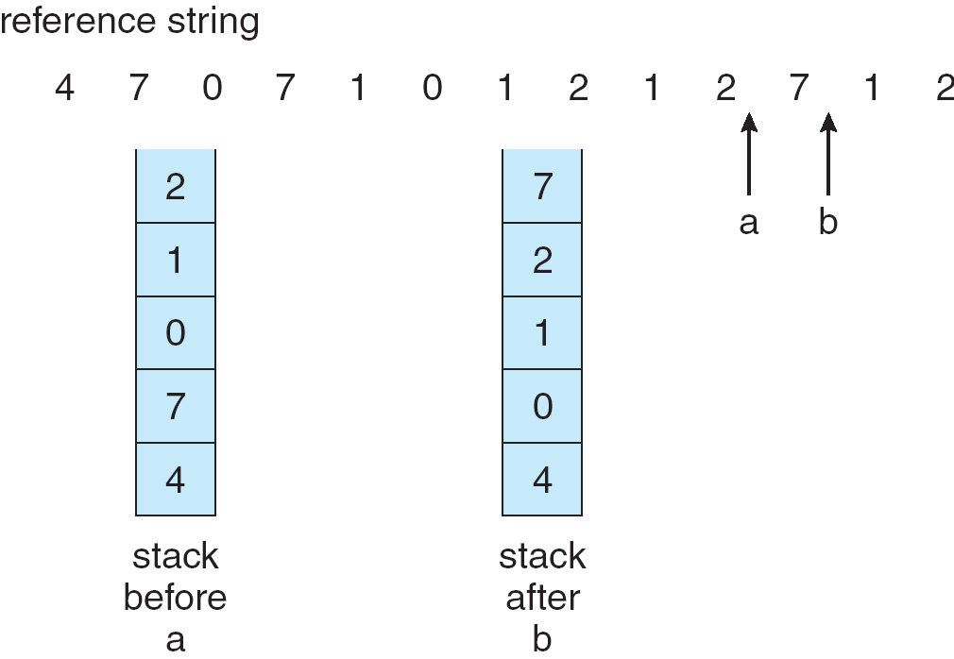
Use Of A Stack to Record The Most Recent Page References
Notes:
111

Slide 112
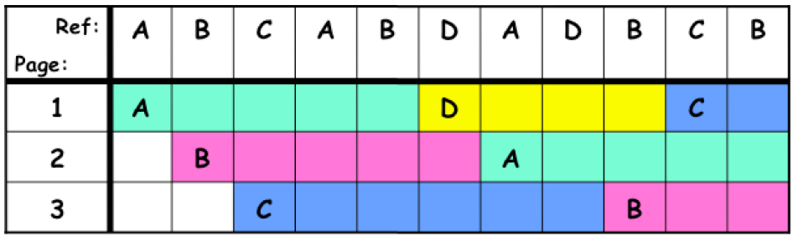
Comparing the Algorithms
FIFO: Suppose we have 3 frames, 4 pages, and the following reference stream
A B C A B D A D B C B
7 Faults
When referencing D, replacing A is a bad choice, since we need A again right away

Slide 113

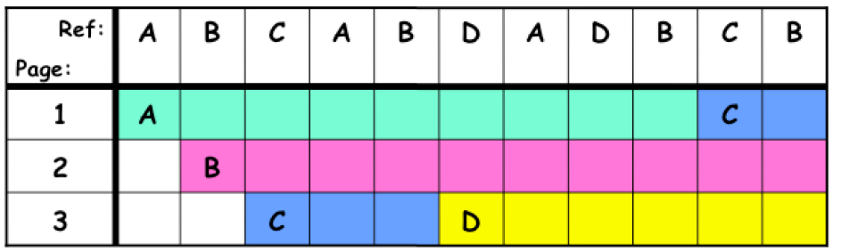
Comparing the Algorithms
MIN: Suppose we have 3 frames, 4 pages, and the following reference stream
A B C A B D A D B C B
5 Faults
D is brought in to the page that will not be referenced for the longest time
How does this compare to LRU?

Slide 114
Comparing the Algorithms
MIN: Suppose we have 3 frames, 4 pages, and the following reference stream
A B C A B D A D B C B
5 Faults
D is brought in to the page that will not be referenced for the longest time
This is the same as LRU (this time)

Slide 115
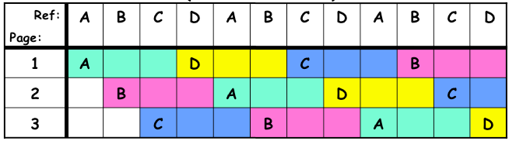
When Will LRU Perform Poorly?
Consider
A B C D A B C D A B C D
Every LRU reference is a page fault!

Slide 116
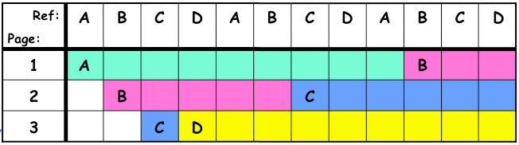
When Will LRU Perform Poorly?
Consider
A B C D A B C D A B C D
MIN does much better

Slide 117
Least Recently Used (LRU) Algorithm
Due to locality, it would seem that LRU would be a good candidate to approximate MIN
But LRU is hard to implement, takes up a lot of space or time.
In practice, we approximate LRU instead.

Slide 118
LRU Approximation Algorithms
Reference bit
With each page associate a bit, initially = 0
When page is referenced bit set to 1
Replace the one which is 0 (if one exists)
We do not know the order, however
Second chance
Need reference bit
Clock replacement
If page to be replaced (in clock order) has reference bit = 1 then:
set reference bit 0
leave page in memory
replace next page (in clock order), subject to same rules
Notes:
118

Slide 119
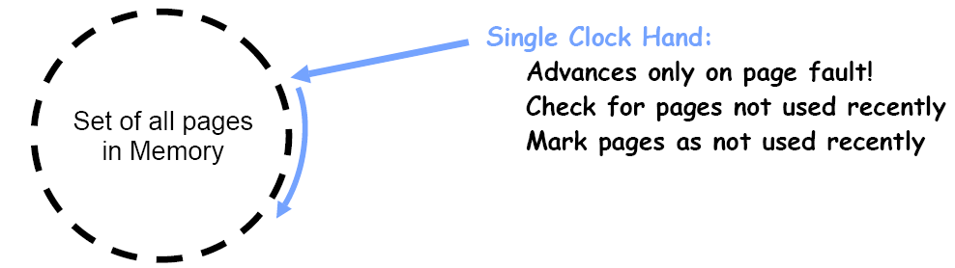
Clock Algorithm
Arrange physical pages in circle with single clock hand
Replace an old page, not the oldest page
Approximation to LRU, hence an approximation to an approximation of MIN
Details
Hardware “use” bit per physical page
Hardware sets use bit on each reference
If use bit isn’t set, means not referenced for a long time
Nachos hardware sets use bit in the TLB, you have to copy this back to page table when TLB entry gets replaced
On Page Fault
Advance clock hand (not real time)
Check use bit: 1 == used recently; clear and leave alone, 0 == selected candidate for replacement
Even if all use bits set, will eventually loop around; in which case, resort to FIFO

Slide 120
Clock Algorithm
What if hand moving slowly?
Good sign or bad sign?
Not many page faults and/or find page quickly
What if hand moving quickly?
Lots of page faults and/or lots of reference bits set
One way to view clock algorithm
Crude partitioning of pages into two groups: young and old
Why not partition into more groups?
Clock Algorithm a.k.a. “Second Chance” – could have Nth chance, too!
Counting algorithms

Slide 121

Second-Chance (clock) Page-Replacement Algorithm
Notes:
121

Slide 122

Counting Algorithms: Nth Chance Version of Clock Algorithm
Nth Chance Algorithm: OS keeps counter per page: # sweeps
On page fault, OS checks use bit:
1 == clear use and also clear counter (used in last sweep)
0 == increment counter, if count = N, replace page
So the clock hand has to sweep by N times without page being used before page is replaced
How do we pick N?
Why pick large N?
Why pick small N?
What about dirty pages?

Slide 123

Counting Algorithms: Nth Chance Version of Clock Algorithm
Nth Chance Algorithm: OS keeps counter per page: # sweeps
On page fault, OS checks use bit:
1 == clear use and also clear counter (used in last sweep)
0 == increment counter, if count = N, replace page
So the clock hand has to sweep by N times without page being used before page is replaced
How do we pick N?
Why pick large N?
Better approximation to LRU: If N ~ 1K, really good approximation
Why pick small N?
Might have to look a long way to find a free page with large N
What about dirty pages?

Slide 124
Counting Algorithms: Nth Chance Version of Clock Algorithm
What about Dirty Pages?
Takes extra overhead to replace a dirty page, so give dirty pages an extra chance before replacing?
Common approach
Clean pages, use N = 1
Dirty pages, use N = 2, and write back to disk when N = 1

Slide 125
Counting Algorithms
Keep a counter of the number of references that have been made to each page
LFU Algorithm: replaces page with smallest count
MFU Algorithm: based on the argument that the page with the smallest count was probably just brought in and has yet to be used
Notes:
125

Slide 126
Clock Algorithms: Details
Which bits of a PTE entry are useful to us?
Do we really need hardware-supported modified bit?

Slide 127
Clock Algorithms: Details
Which bits of a PTE entry are useful to us?
Use: set when a page is referenced; cleared by clock algorithm
Modified (Dirty): set when a page is modified, cleared when a page is written to disk
Valid: ok for program to reference this page
Read-Only: ok for program to read page, but not modify
For example, for catching modifications to code pages
Do we really need hardware-supported modified bit?

Slide 128
Clock Algorithms: Details
Which bits of a PTE entry are useful to us?
Use: set when a page is referenced; cleared by clock algorithm
Modified (Dirty): set when a page is modified, cleared when a page is written to disk
Valid: ok for program to reference this page
Read-Only: ok for program to read page, but not modify
For example, for catching modifications to code pages
Do we really need hardware-supported modified bit?
No, we can emulate it using a read-only bit

Slide 129
Clock Algorithms: Details
Which bits of a PTE entry are useful to us?
Use: set when a page is referenced; cleared by clock algorithm
Modified (Dirty): set when a page is modified, cleared when a page is written to disk
Valid: ok for program to reference this page
Read-Only: ok for program to read page, but not modify
For example, for catching modifications to code pages
Do we really need hardware-supported modified bit?
No, we can emulate it (BSD Unix) using a read-only bit
Initially, mark all pages as read only (even the data pages)
On write, trap to the OS, OS software sets software modified bit, and marks page as read-write
When page comes back in from disk, mark read-only

Slide 130
Clock Algorithms: Details
Do we really need a hardware-supported use bit?
No, we can emulate it similar to the modified bit
Mark all pages as invalid, even if in memory
On read to invalid page, trap to OS
OS sets use bit, and marks page read-only
Get modified bit in same way as previous
On write, trap to OS (either invalid or read-only)
Set use and modified bits, mark page read-write
When clock hand passes by, reset use and modified bits and mark page as invalid again
Remember, however, that clock is just an approximation of LRU
Can we do a better approximation, given that we have to take page faults on some reads and writes to collect use information?
Need to identify old page, not the oldest page!
Answer: second chance list

Slide 131
Allocation of Frames
Each process needs minimum number of pages
Example: IBM 370 – 6 pages to handle SS MOVE instruction:
instruction is 6 bytes, might span 2 pages
2 pages to handle from
2 pages to handle to
Two major allocation schemes
fixed allocation
priority allocation
Notes:
131

Slide 132

Free List
Keep set of free frames ready for use in demand paging
Free list filled in background by clock algorithm or other technique (clock daemon)
Dirty pages start copying back to disk when they enter the list
Like VAX second-chance list
If page needed before reused, just return to the active set
Advantage: faster for page fault
Can always use page (or pages) immediately on fault

Slide 133
Fixed Allocation
Equal allocation – For example, if there are 100 frames and 5 processes, give each process 20 frames.
Proportional allocation – Allocate according to the size of process
Notes:
133

Slide 134
Priority Allocation
Use a proportional allocation scheme using priorities rather than size
If process P_{i} generates a page fault,
select for replacement one of its frames
select for replacement a frame from a process with lower priority number
Notes:
134

Slide 135
Global vs. Local Replacement
Global replacement – process selects a replacement frame from the set of all frames; one process can take a frame from another
Local replacement – each process selects from only its own set of allocated frames
Priority Allocation may, if using global replacement, select for replacement a frame from a process with lower priority.
Notes:
135

Slide 136

Adaptive Allocation based on Page Fault Frequency
Can we reduce capacity misses by dynamically changing the number of pages per application?
Establish “acceptable” page fault rate
If rate is too low, process loses a frame to a process that needs it
If rate is too high, process gains a frame
But what if we just don’t have enough memory?

Slide 137
Thrashing
If a process does not have “enough” pages, the page-fault rate is very high. This leads to:
low CPU utilization
operating system thinks that it needs to increase the “degree of multiprogramming” (number of ready processes)
another process added to the ready queue
Which requires more memory, leading to more page faults, leading to lower CPU utilization, and the cycle continues…
Thrashing ≡ a process is busy swapping pages in and out
How do we detect and respond to thrashing?
Notes:
137

Slide 138

Thrashing (Cont.)
Notes:
138

Slide 139

Locality In A Memory-Reference Pattern
Notes:
139

Slide 140
Locality In A Memory-Reference Pattern
Program memory access patterns have temporal and spatial locality
Group of pages accessed along a given time slice is called the “Working Set”
Working Set defines the minimum number of pages needed for the process to “behave well”
Not enough memory for the working set == Thrashing
Better to swap out process?
Notes:
140

Slide 141

Working-Set Model
Δ ≡ working-set window ≡ a fixed number of page references Example: 10,000 instruction
WSS_{i} (working set of Process P_{i}) = total number of pages referenced in the most recent Δ (varies in time)
if Δ too small will not encompass entire locality
if Δ too large will encompass several localities
if Δ = ∞ ⇒ will encompass entire program
D = Σ WSS_{i} ≡ total demand frames
if D > m ⇒ Thrashing
Policy if D > m, then suspend one of the processes
Notes:
141

Slide 142

Working Sets and Page Fault Rates

Slide 143
Keeping Track of the Working Set
Approximate with interval timer + a reference bit
Example: Δ = 10,000
Timer interrupts after every 5000 time units
Keep in memory 2 bits for each page
Whenever a timer interrupts copy and sets the values of all reference bits to 0
If one of the bits in memory = 1 ⇒ page in working set
Why is this not completely accurate?
Improvement = 10 bits and interrupt every 1000 time units
Notes:
143

Slide 144
Memory Hierarchy Tour
Given a word address, how do we traverse the cache and virtual memory system to get that word?
Suppose: 32-bit address space and word size, 4K pages, 2GB of physical memory, 64K 2-way set associative L1 cache with 32-byte blocks, 2MB 4-way set associative L2 cache with 32-byte blocks. L1 cache is virtually addressed, and assume that a fully-associative TLB is present (but this request is a miss at all levels).

Slide 145
Linux Pages
Linux pages are defined as a struct_page in linux/mm.h
typedef struct page {
struct list_head list;
struct address_space *mapping;
unsigned long index;
struct page *next_hash;
atomic_t count;
unsigned long flags;
struct list_head lru;
unsigned char age;
unsigned char zone;
struct pte_chain * pte_chain;
struct page **pprev_hash;
struct buffer_head * buffers;
#if defined(CONFIG_HIGHMEM) || defined(CONFIG_SPARC64)
void *virtual;
#endif /* CONFIG_HIGMEM || CONFIG_SPARC64 */
} mem_map_t;

Slide 146
Linux Pages
count:reference count
flags: bit field including dirty bit, etc.
See linux/page-flags.h
virtual: virtual address

Slide 147
Zones
ZONE_DMA
Allows hardware performing DMA to have memory addresses mapped where they need them
ZONE_NORMAL
ZONE_HIGHMEM
Dynamically mapped at addresses higher than what may be virtually addressed
struct zone in linux/mmzone.h

Slide 148
Kernel Page Allocation
linux/mm.h and mm/page_alloc.c
alloc_page (return the page structure), get_free_page (return logical address)
free_page(logical_address)
Or, linux/slab.h for continuous slab
kmalloc(size, flag) and kfree(ptr)
Or, linux/vmalloc.h and mm/vmalloc.c for noncontinuous physical page allocation
vmalloc(size)

Slide 149
Memory-Mapped Files
Memory-mapped file I/O allows file I/O to be treated as routine memory access by mapping a disk block to a page in memory
A file is initially read using demand paging. A page-sized portion of the file is read from the file system into a physical page. Subsequent reads/writes to/from the file are treated as ordinary memory accesses.
Simplifies file access by treating file I/O through memory rather than read() write() system calls
Also allows several processes to map the same file allowing the pages in memory to be shared
Notes:
149

Slide 150

Memory Mapped Files
Notes:
150

Slide 151

Memory-Mapped Shared Memory in Windows
Notes:
151

Slide 152
Allocating Kernel Memory
Treated differently from user memory
Often allocated from a free-memory pool
Kernel requests memory for structures of varying sizes
Some kernel memory needs to be contiguous
Notes:
152

Slide 153
Buddy System
Allocates memory from fixed-size segment consisting of physically-contiguous pages
Memory allocated using power-of-2 allocator
Satisfies requests in units sized as power of 2
Request rounded up to next highest power of 2
When smaller allocation needed than is available, current chunk split into two buddies of next-lower power of 2
Continue until appropriate sized chunk available
Notes:
153

Slide 154

Buddy System Allocator
Notes:
154

Slide 155
Slab Allocator
Alternate strategy
Slab is one or more physically contiguous pages
Cache consists of one or more slabs
Single cache for each unique kernel data structure
Each cache filled with objects – instantiations of the data structure
When cache created, filled with objects marked as free
When structures stored, objects marked as used
If slab is full of used objects, next object allocated from empty slab
If no empty slabs, new slab allocated
Benefits include no fragmentation, fast memory request satisfaction
Notes:
155

Slide 156

Slab Allocation
Notes:
156

Slide 157
Other Issues -- Prepaging
Prepaging
To reduce the large number of page faults that occurs at process startup
Prepage all or some of the pages a process will need, before they are referenced
But if prepaged pages are unused, I/O and memory was wasted
Assume s pages are prepaged and α of the pages is used
Is cost of s * α save pages faults > or < than the cost of prepaging s * (1- α) unnecessary pages?
α near zero: prepaging loses
Notes:
157

Slide 158
Other Issues – Page Size
Page size selection must take into consideration:
fragmentation
table size
I/O overhead
locality
Notes:
158

Slide 159
Other Issues – TLB Reach
TLB Reach - The amount of memory accessible from the TLB
TLB Reach = (TLB Size) X (Page Size)
Ideally, the working set of each process is stored in the TLB
Otherwise there is a high degree of page faults
Increase the Page Size
This may lead to an increase in fragmentation as not all applications require a large page size
Provide Multiple Page Sizes
This allows applications that require larger page sizes the opportunity to use them without an increase in fragmentation
Notes:
159

Slide 160
Other Issues – Program Structure
Program structure
Int[128,128] data;
Each row is stored in one page
Program 1
for (j = 0; j <128; j++) for (i = 0; i < 128; i++) data[i,j] = 0;
128 x 128 = 16,384 page faults
Program 2
for (i = 0; i < 128; i++) for (j = 0; j < 128; j++) data[i,j] = 0;
128 page faults
Notes:
160

